Slide 1
Using Data Mining To Improve Business In Chain Restaurant
Group project of Data Mining and Warehousing (CSL-515) by:
Ujjwal Singh (24911013), Ruchi Kumari (24911019), Munugala Charan Tej (21114062), Ganga Srujan (21114035), Bandi Pavan Karthik (21114026)

Slide 2
Outlines
Introduction
Data Collection And Sources
Methodology
Data Preprocessing
Clustering Algorithms
Evaluation Metrics
Inferences
Conclusion
Future Scope
References

Slide 3
Introduction
“Application of Data mining to improve Chain Restaurant Business”
Discovering hidden patterns, trends, and insights from large datasets. [1]
Key Techniques
Association Rules
Clustering
Classification
Regression Analysis
Sentiment Analysis
Why Data Mining Matters for Chains
Improved Operational Efficiency
Strategic Business Growth
Enhanced Customer Experience

Slide 4
Data Collection & Sources
Data Types
Contains 9,551 restaurant records from 15 different countries with details on cuisines, pricing, table booking availability, online delivery, user ratings, and more
Useful for food business analysis, recommendation systems, price prediction, and sentiment analysis.
Data Sources [2]
Title: mcdonalds-stores-data
Platform: Kaggle (https://www.kaggle.com/)
Description:
Contains global restaurant data (ratings, cuisines, locations, menu items).
Used to analyze customer preferences, regional trends, and menu performance.

Slide 5
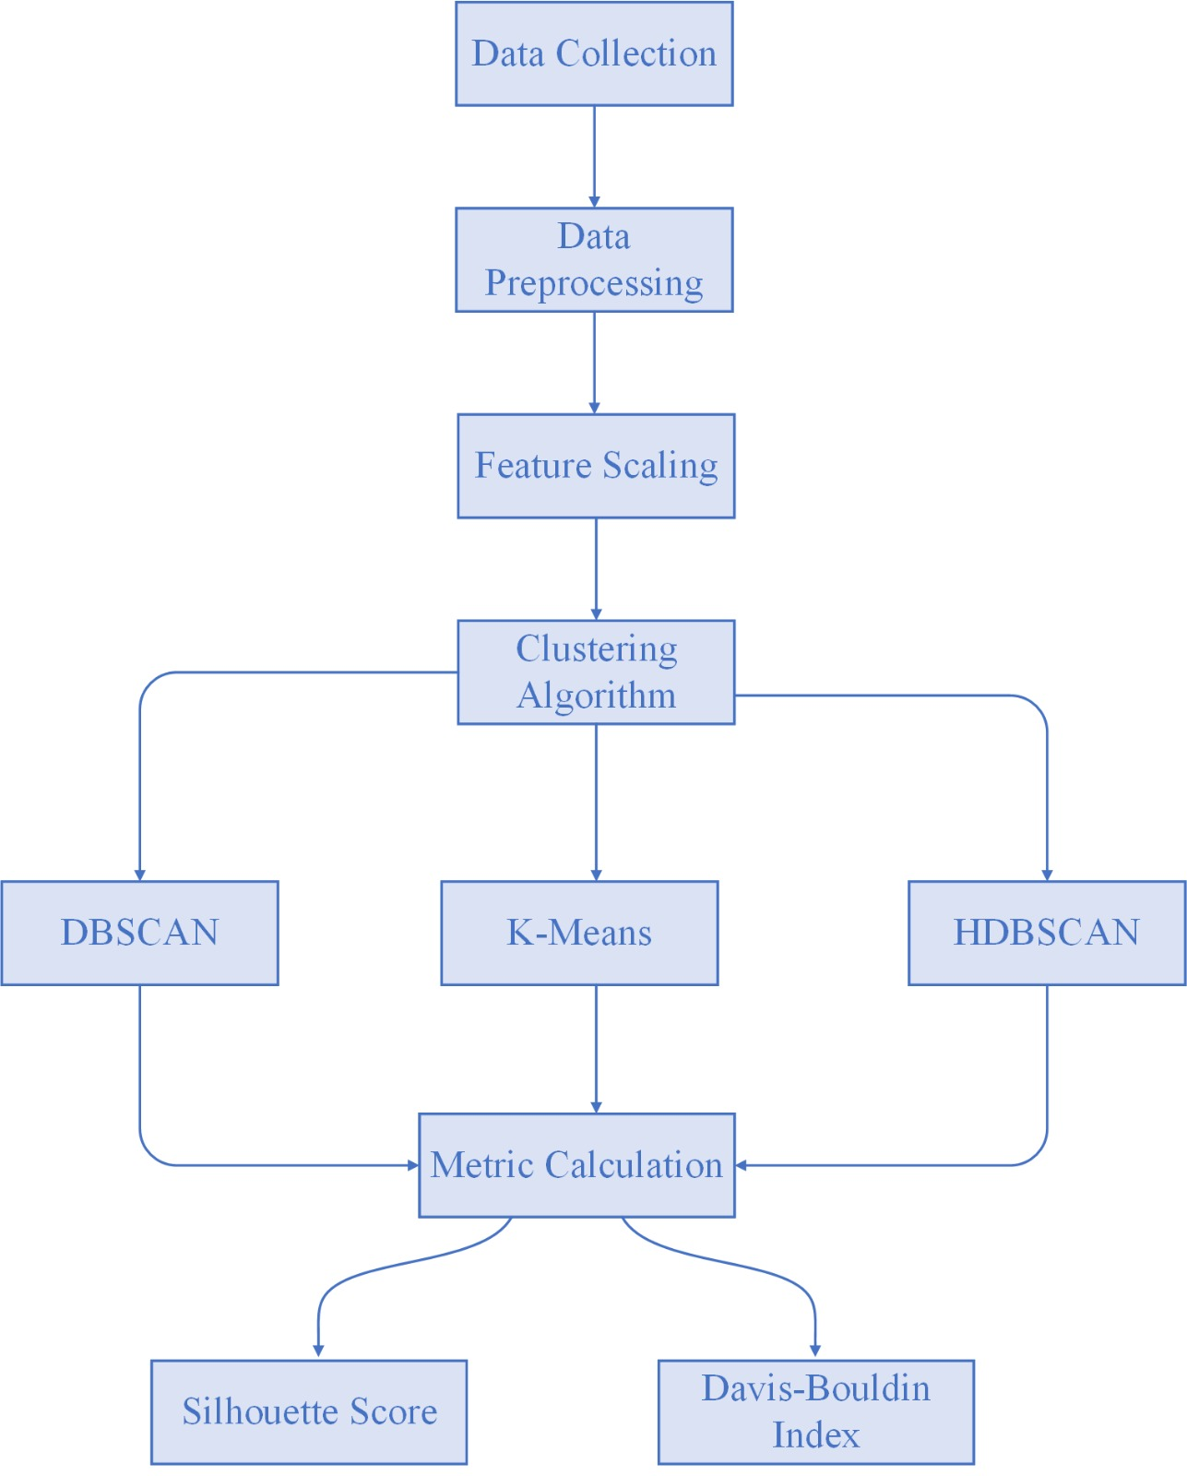
Methodology

Slide 6
Data Loading & Preprocessing
Dataset Collection
Downloaded via KaggleHub, containing store locations with latitude and longitude.
Data preprocessing
Drops rows with missing coordinates to ensure valid geospatial data.
Scaling
Uses standardScalar to normalize latitude/longitude.
Clustering algorithms like DBSCAN/K-Means are sensitive to feature scales. Standardization ensures equal weighting.

Slide 7
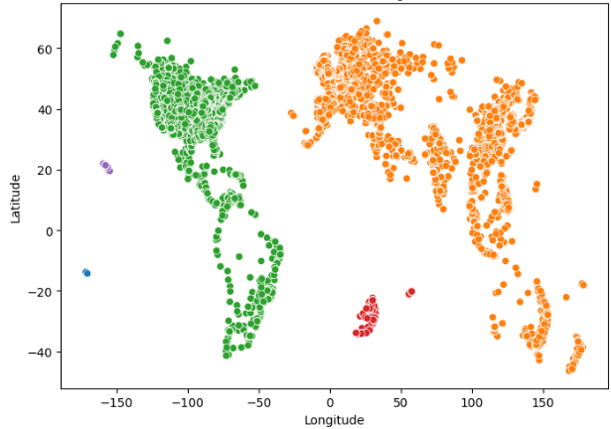
Clustering Algorithms
DBSCAN (Density-Based)
Parameters: eps:0.3 (max distance between points), min_samples=10 (min points to form a cluster).
Strength: Finds arbitrary-shaped clusters and Identifies noise points (label-1)
Shortcoming: Requires careful tuning of eps and min_samples.

Slide 8
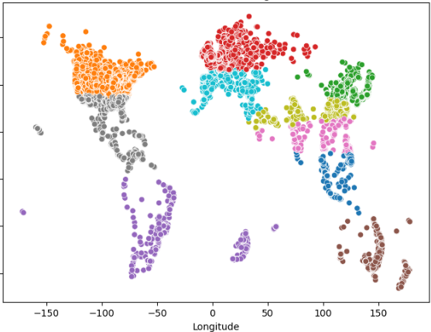
Clustering Algorithms
K-Means (Centroid-Based)
Parameters: n_clusters=10(predefined number of clusters).
Strength: Fast and simple for spherical clusters
Shortcoming: Assumes clusters of similar size/density; requires specifying n_clusters.

Slide 9
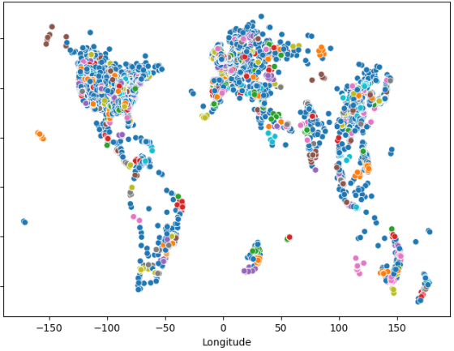
Clustering Algorithms
HDBSCAN (Hierarchical Density-Based)
Parameters: min_cluster_size=10 (smallest group to consider a cluster).
Strength: Handles varying densities and automatically determines cluster count.
Shortcoming: Computationally heavier than DBSCAN

Slide 10
Evaluation Metrics
Silhouette Score:
Measures cohesion/separation of clusters.
Range: [-1,1] (higher = better).
Davies-Bouldin Index:
Measures average similarity between clusters
Lower values indicate better separation.
Comparative Study
Metric | K-Means | DBSCAN | HDBSCAN
Silhouette Score | 0.4891 | 0.2911 | 0.6636
Davies-Bouldin Index | 0.7571 | 0.7350 | 0.3480

Slide 11
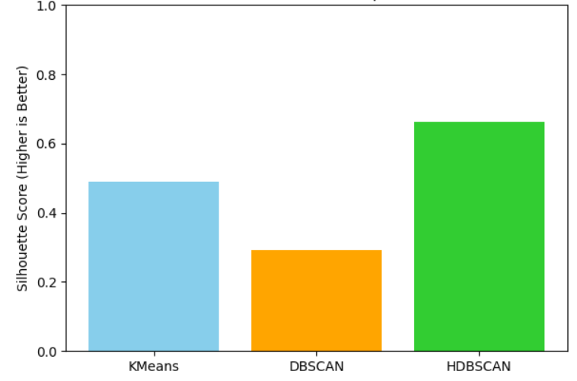
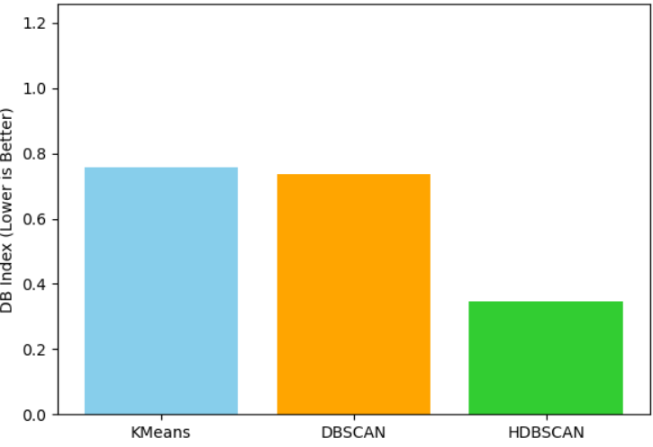
Clustering Algorithm Performance Metrics
Silhouette Score
Davies-Bouldin Index

Slide 12
Inferences
Why HDBSCAN Wins:
Higher scores → Better-defined clusters → More reliable insights.
Business Benefits:
Reveals natural clusters and outliers.
Identifies over-saturation and expansion opportunities.
Provides actionable insights for streamlining operations.
Informed, data-driven decisions that improve efficiency, revenue, and customer reach.

Slide 13
Conclusion
Data mining via clustering reveals powerful geographic patterns in store locations. Using advanced clustering, chain restaurants can:
Optimize regional operations
Detect market saturation
Plan targeted expansion
Launch location-specific campaigns
Clustering transforms static location data into dynamic maps of opportunity, empowering businesses to make smarter, faster, and more confident decisions.

Slide 14
Future Scope
Explore more advanced clustering methods (e.g., Gaussian Mixture Models).
Integrate additional features like population density or sales data for richer analysis.
Temporal analysis of store openings.

Slide 15
References
[1] Sclove, Stanley. “Data Mining on Time Series: an Illustration Using Fast-Food Restaurant Franchise Data.” Computational Statistics & Data Analysis, 2001.
[2] Data Link: www.kaggle.com/api/v1/datasets/download/
[3] Berkhin, P., A survey of clustering data mining techniques, in Grouping multidimensional data: Recent advances in clustering. 2006, Springer. p. 25-71.

Slide 16
Thank You

